Slide 1


LENDING CLUB CASE STUDY

Slide 2

LENDING CLUB CASE STUDY
Trapti Agarwal
Kushalava Reddy Yanala

Slide 3
Table of Contents
Problem Statement
Data Cleaning and Manipulation
Univariate Analysis
Bivariate Analysis
Multi Variate Analysis
Recommendations

Slide 4
Problem Statement

Slide 5
Problem Statement:
Lending Club is a Consumer Finance Company, which is specialised in lending the various types of loan to customers. Lending the loan to ‘Risky’ applicants causes the financial loss to the lenders.
The objective of this case study is to identify the Risky applicants and helps in cutting down the amount of credit loss to Organization.

Slide 6
Data Cleaning and Manipulation

Slide 7
2. Data Cleaning and Manipulation
Data Cleaning
As part of Fixing rows and columns:
Columns with NA values were deleted (54 columns)
Columns with only 1 value for all 39717 rows were deleted (9 columns)
Text columns with 39717 values were deleted (4 columns)
As part of missing values:
Columns with very % of values missing were deleted (3 columns)
As part of Standardizing values:
term, int_rate and revol_util columns were standardized by removing “months” from the first columns and “%” from the remaining 2 columns
As part of Filtering rows and columns:
Removed the outliers for salary (more than 99 percentile)

Slide 8
2. Data Cleaning and Manipulation
Data Transformation
As part of Data Typecasting:
Converted term column to int
Converted int_rate and revol_util to float
As part of deriving new columns:
Derived month and year column from issue_d column
Derived charged off ratio for multiple parameters using the number of charged of loans/ total no. of loans in the category

Slide 9
Univariate Analysis

Slide 10
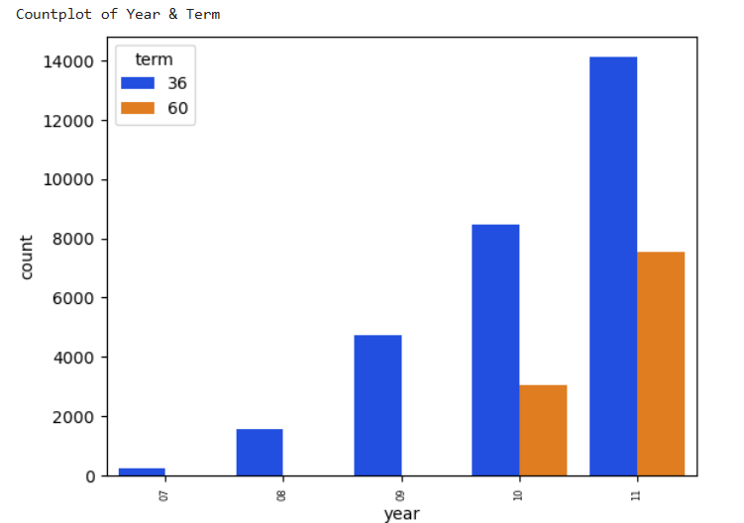
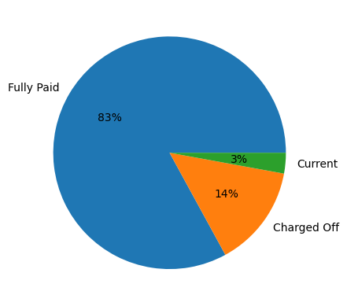
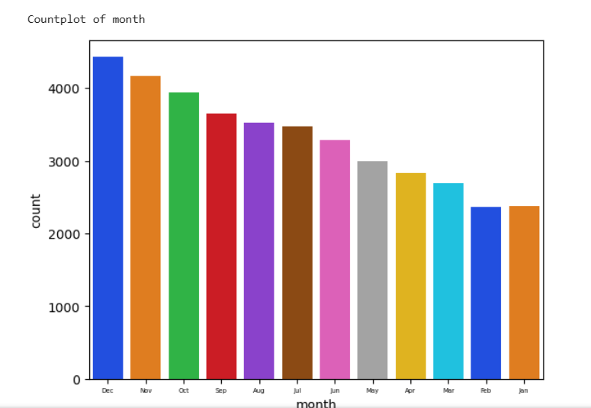
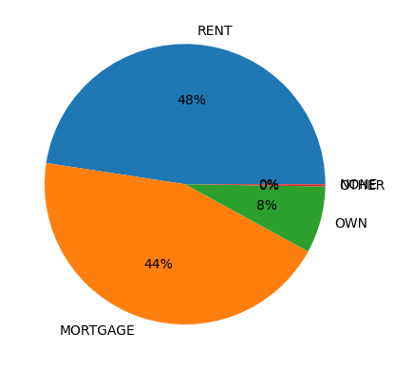
Observations:
Number of loans issued have increased every year from 2007 to 2011
Most of the loans are given in the last quarter
83% of the loans are Fully paid customer
92% of the loan customers are either rented or mortgaged homes

Slide 11
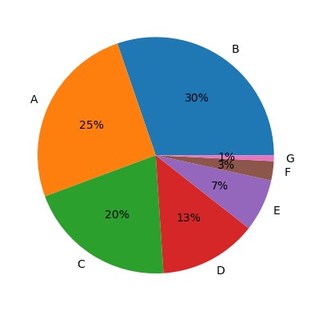
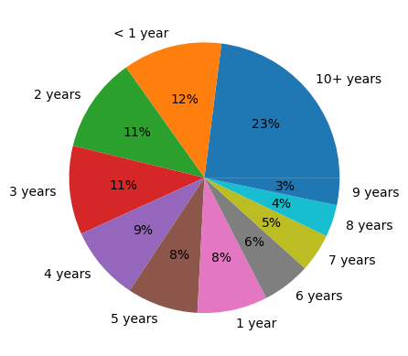
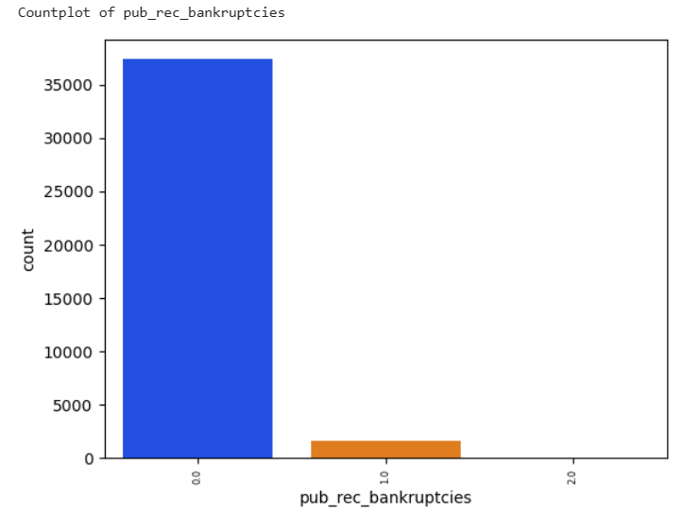
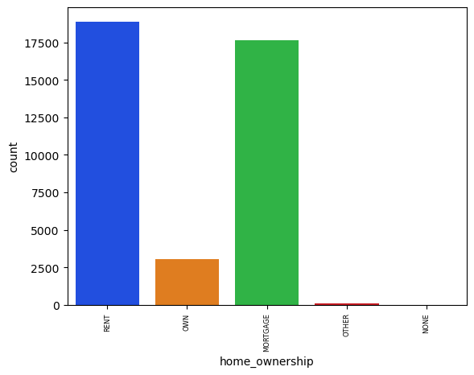
Majority loans are given for grade A, B and C
Observations:
Majority loans are given for grade A, B and C
More loans are given to customers with more than 10 years of exp
More loans are given to customers with more than 10 years of exp
More customers with rented and mortgaged homes are opting for loans

Slide 12
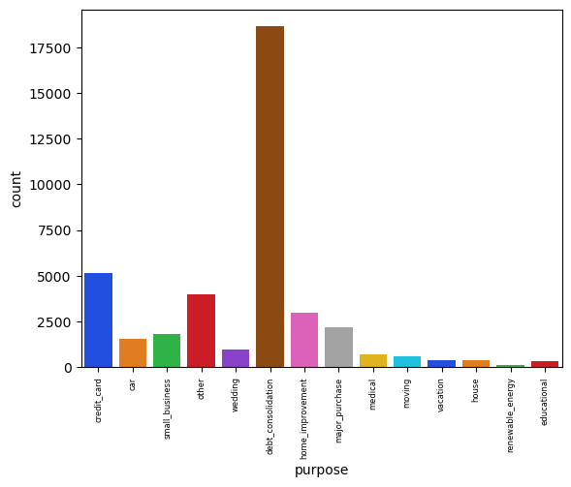
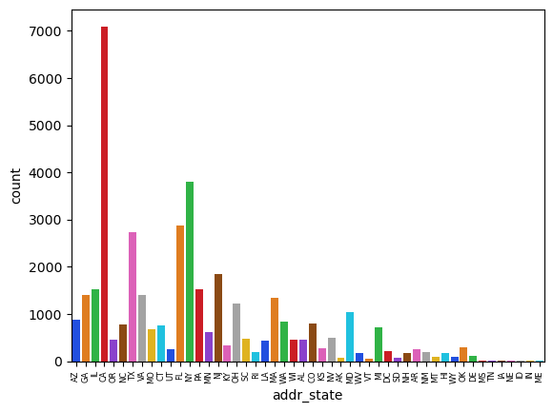
Majority of the customers give ‘debt_consolidation’ as the purpose for loan
Highest number of customers are from CA and NY

Slide 13
Bivariate Analysis

Slide 14
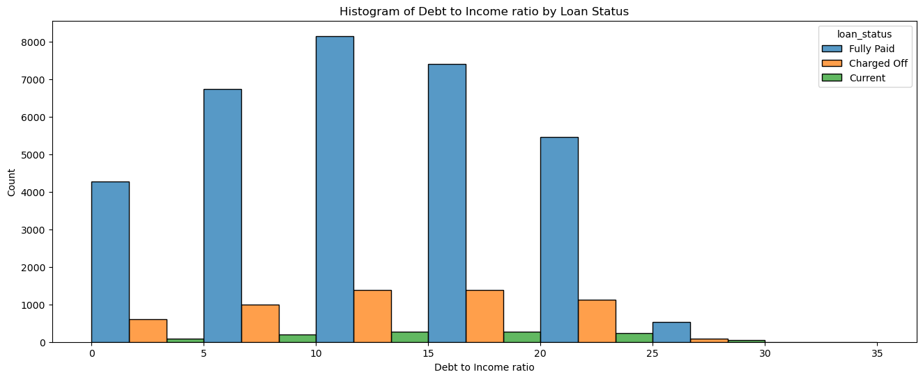
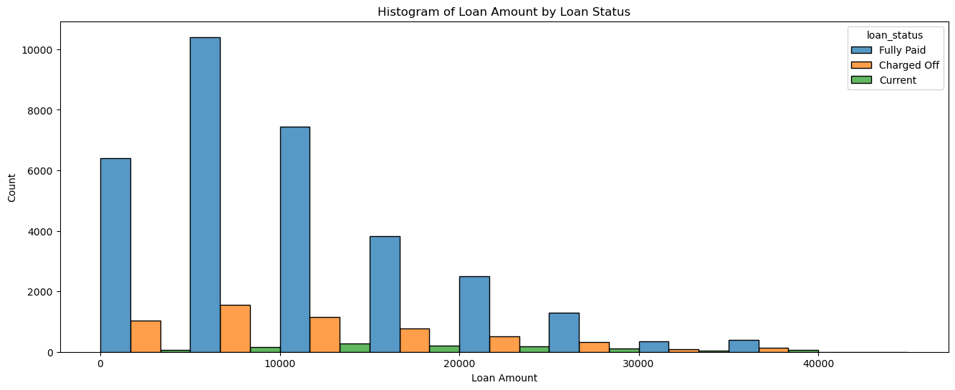
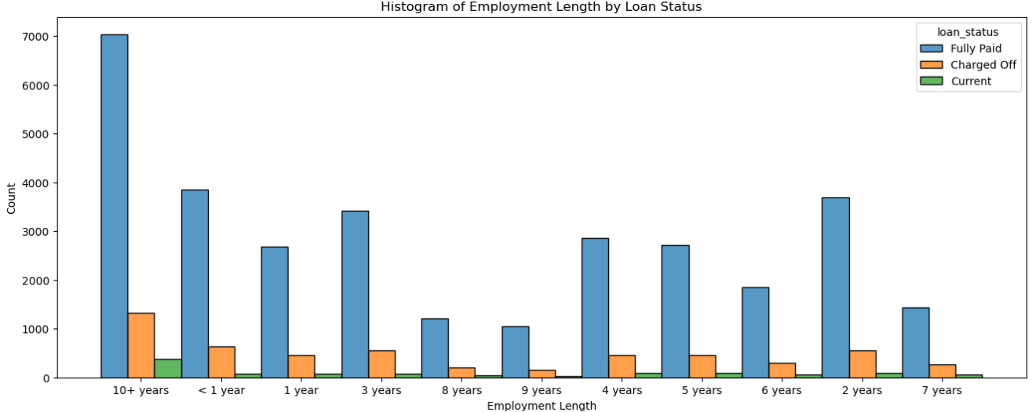
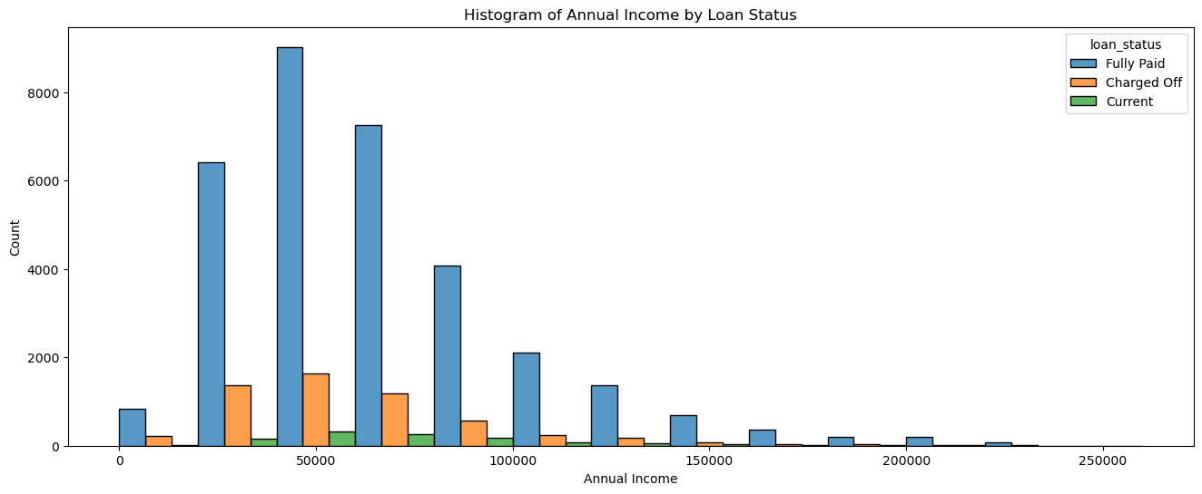
The graphs below are related to various parameters divided by loan status. The pattern for both Fully Paid and Current seems to be similar. It is difficult to conclude anything from these graphs.

Slide 15
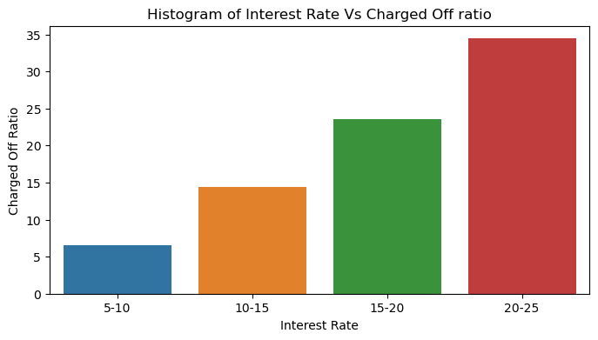
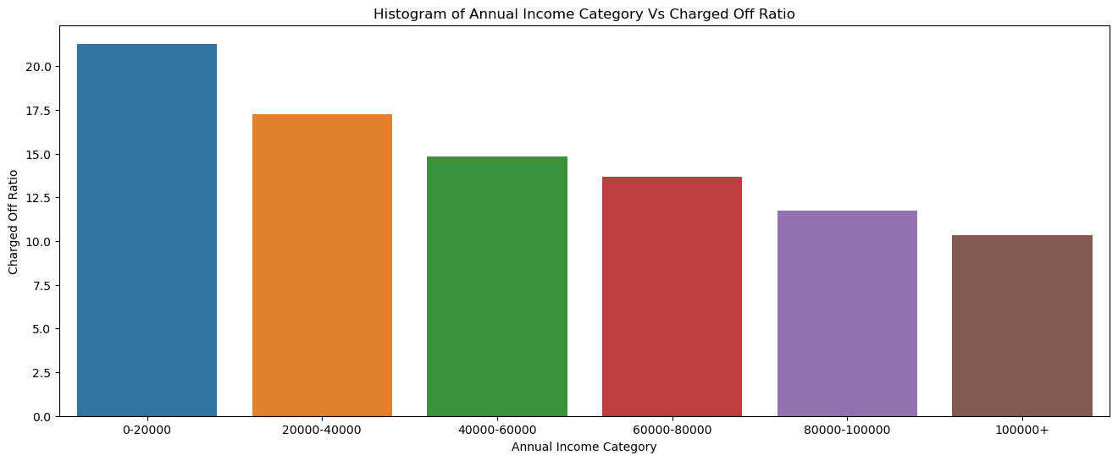
Observations
With the increase in salary, the loan charge off has reduced
With the increase in interest rate, the loan charge off increases

Slide 16
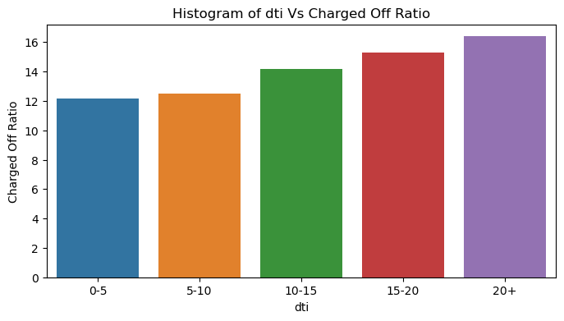
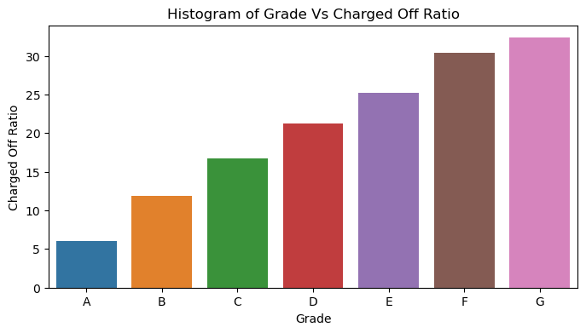
Observations
With increase in dti, the charge off increases
The charge off keeps increasing as we move from Grade A to G

Slide 17
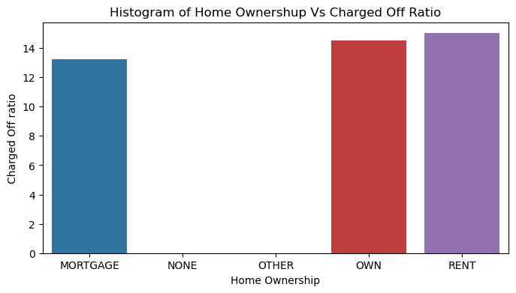
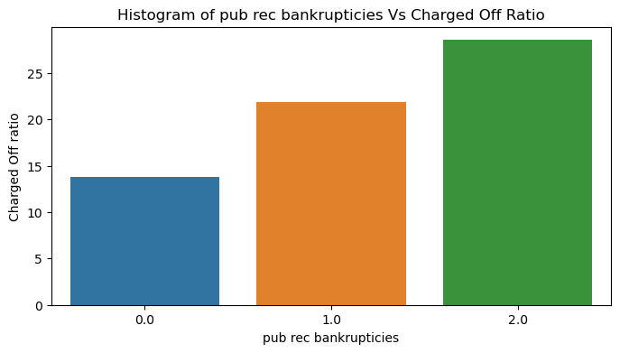
Observation
Customers with Mortgaged homes Charge off less. Own and Rented house customers are charging off equally.
Charge off increases with higher public record bankruptcies. Data for 2 bankruptcies is very less but we have enough data for 1 bankruptcies where charge off is higher than 0 bankruptcies

Slide 18
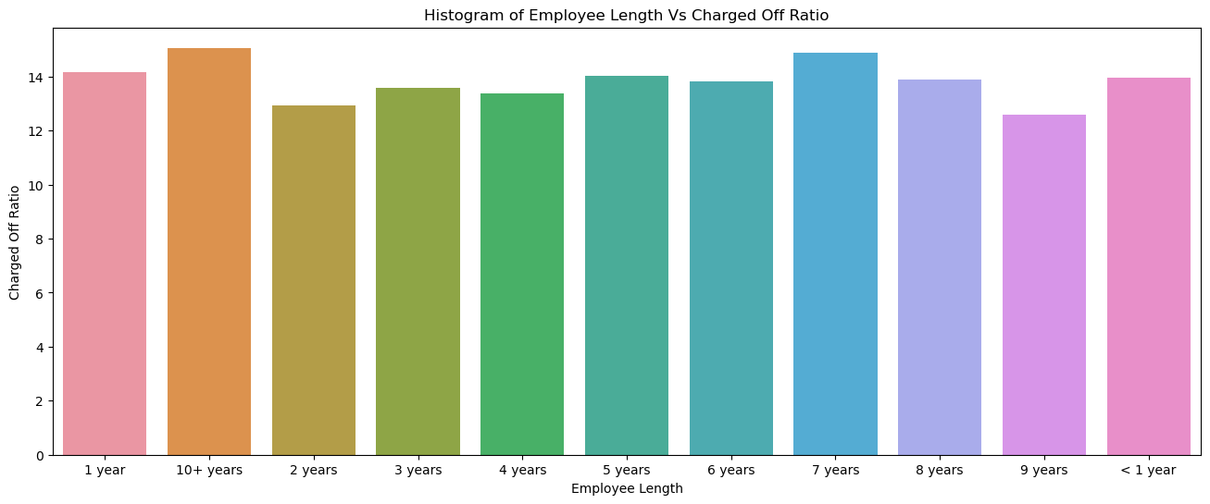
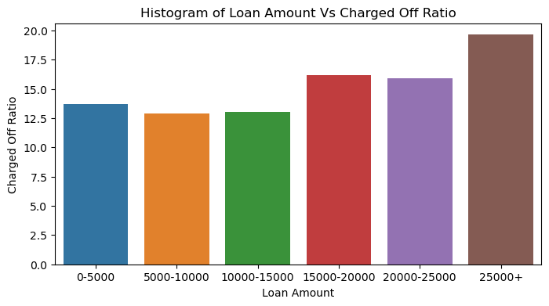
Observations
There is no clear visible pattern in the emp length and the charged off ration therefore no conclusion can be drawn from emp length
Higher charge off with higher loan amount. Highest charge off ration is for the high loan amount 25,000+

Slide 19
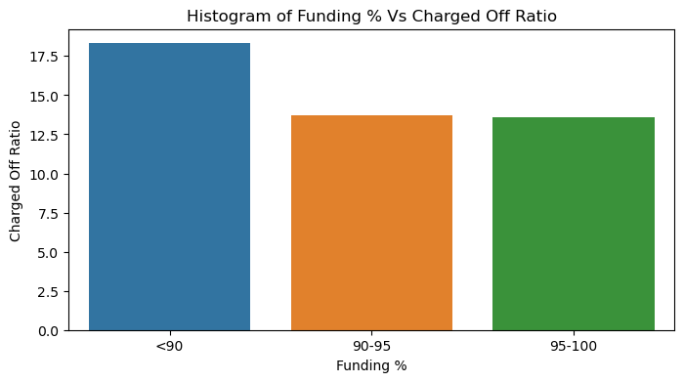
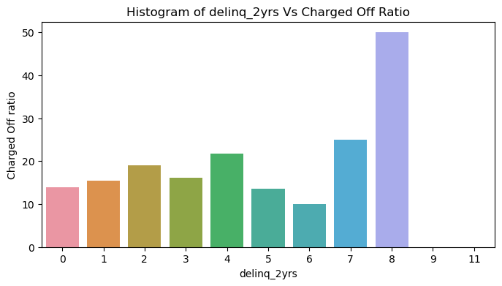
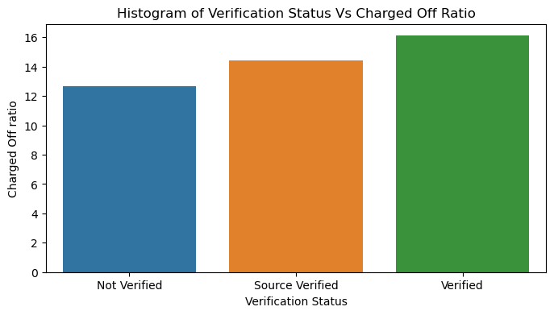
Observations
Loans with lesser funding are more prone to charge off
Nothing can be concluded from this variable as almost 90% of data is 0 for delinq_2yrs and its charge off is lesser than others. For higher number of delinq_2yrs the data is too low to conclude anything.
Difficult to conclude anything related to verification status

Slide 20
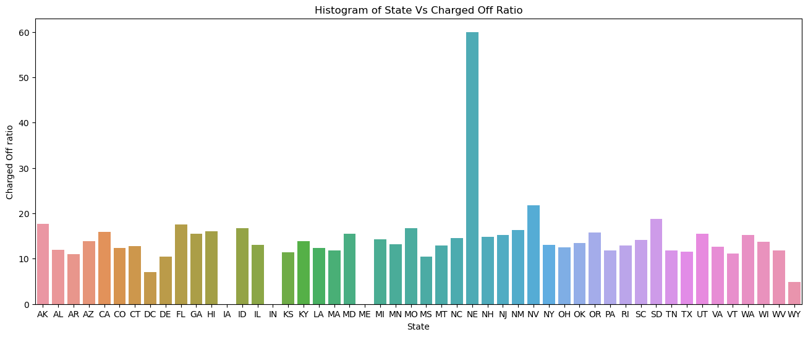
Observations
NE state seems to have the highest charge off ratio but the number of loan applications are too low to generalize. NJ, GA, MD, CA and FL have good number of loan applicants and charge off is also higher.

Slide 21
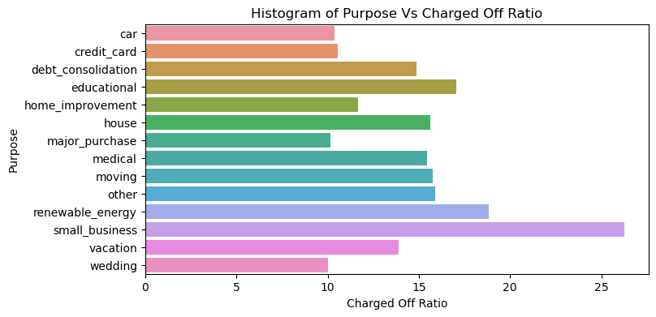
Observation
* Small businesses seems to have the highest charge off ratio

Slide 22
Multivariate Analysis

Slide 23
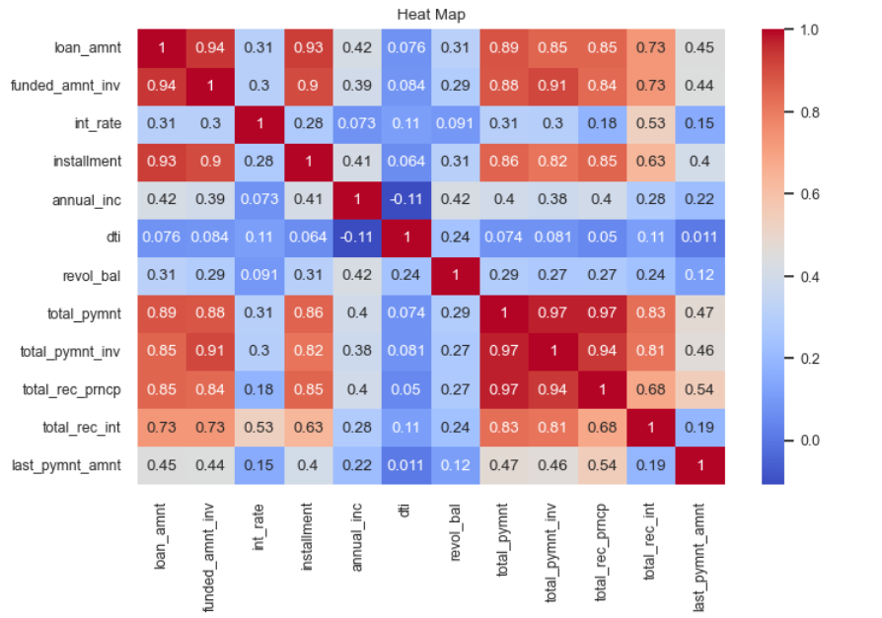
HEAT MAP
Observations:
loan_amt is having strong positive correlation with funded_amnt_inv, total_pymnt, installment
Loan_amt is having intermediate positive correlation with annual_inc , int_rate, revol_bal.
Total_pymnt is having the strong positive correlation with total_pymt_inv.
Annual income is having the negative correlation with dti.

Slide 24
Recommendations

Slide 25
Recommendations:
Customers with lower salary shall not be given loan of higher amount. Also, the interest charged from them shall be lower.
We see the owned and rented home customers are risky applicant and we should limit the loan amount based on the dti ratio.
We see small business loan customers are risky applicants and they charged off more, so we can reduce the interest rate to avoid delay in payments.
Increase the interest for the customers which are in less loan amount for the in moving, vacation , wedding etc.
Loan amount for customers with grade E, F and G shall be limited, as they charge off more.
Customers with less or no funding tend to charge off more so those customer shall be verified on parameters like dti, home ownership etc. before giving the loan.

Slide 26
Thank You !!!

